Slide 1
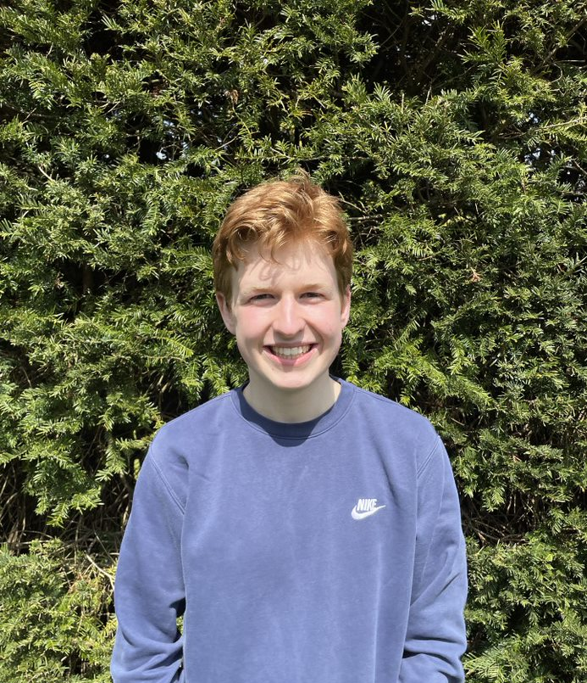
SU PRESIDENT
CARL
SCHOOL : THAMESMEAD SCHOOL
COURSES: ECONOMICS
FRENCH
POLITICS

Slide 2
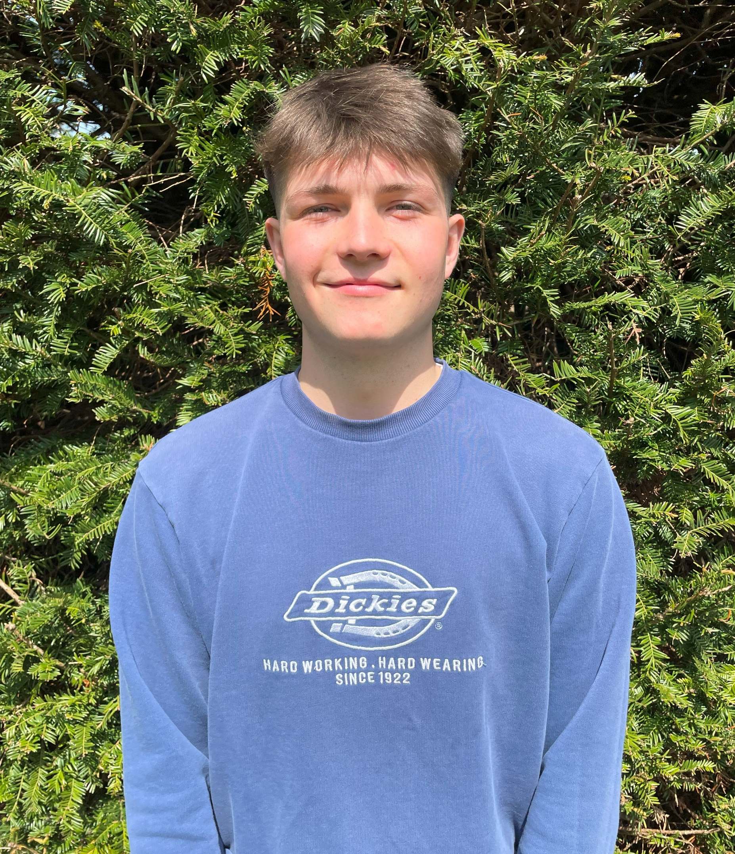
SU VICE PRESIDENT
ROSS
SCHOOL : THAMESMEAD SCHOOL
COURSES: POLITICS
HISTORY
3D DESIGN

Slide 3
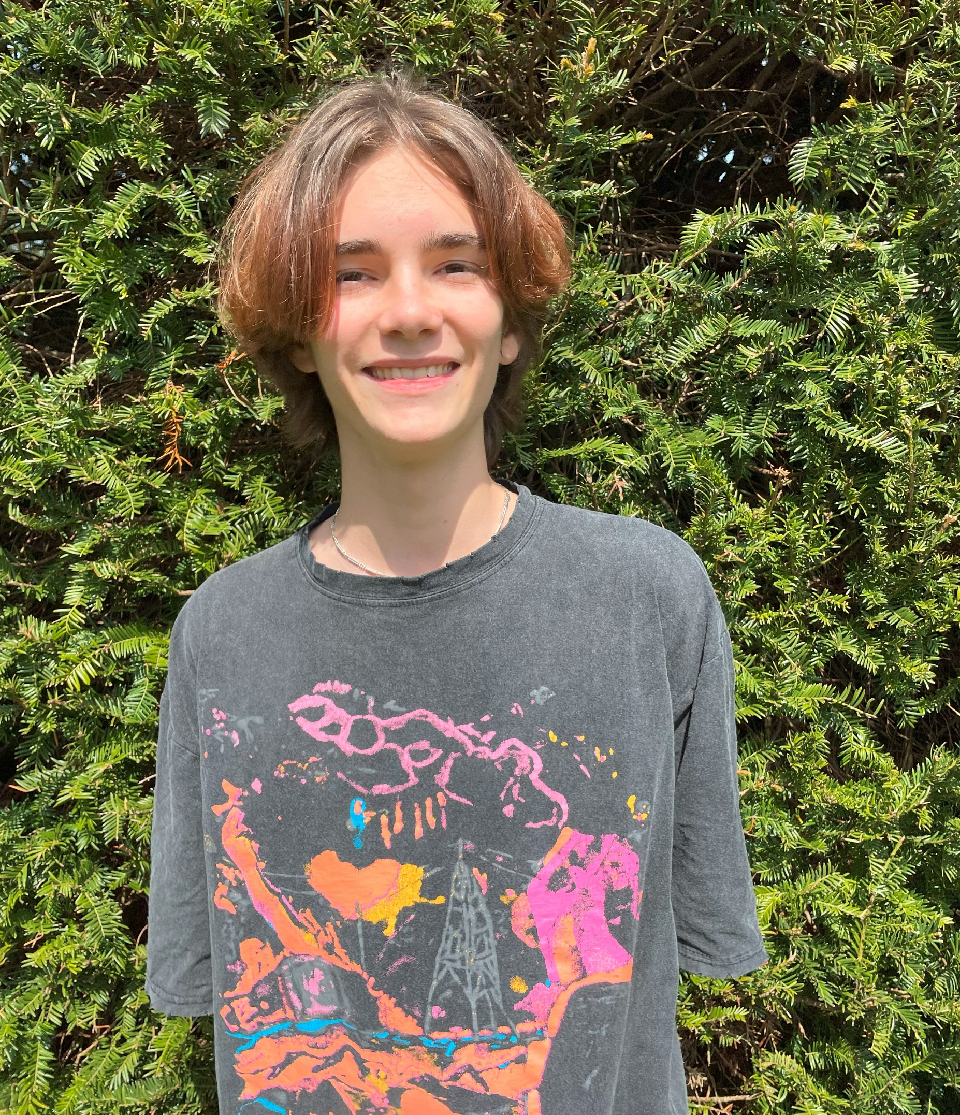
SU ECO EXEC
FREDDIE
SCHOOL : TEDDINGTON SCHOOL
COURSES: PSYCHOLOGY
MATHS
GEOGRAPHY

Slide 4
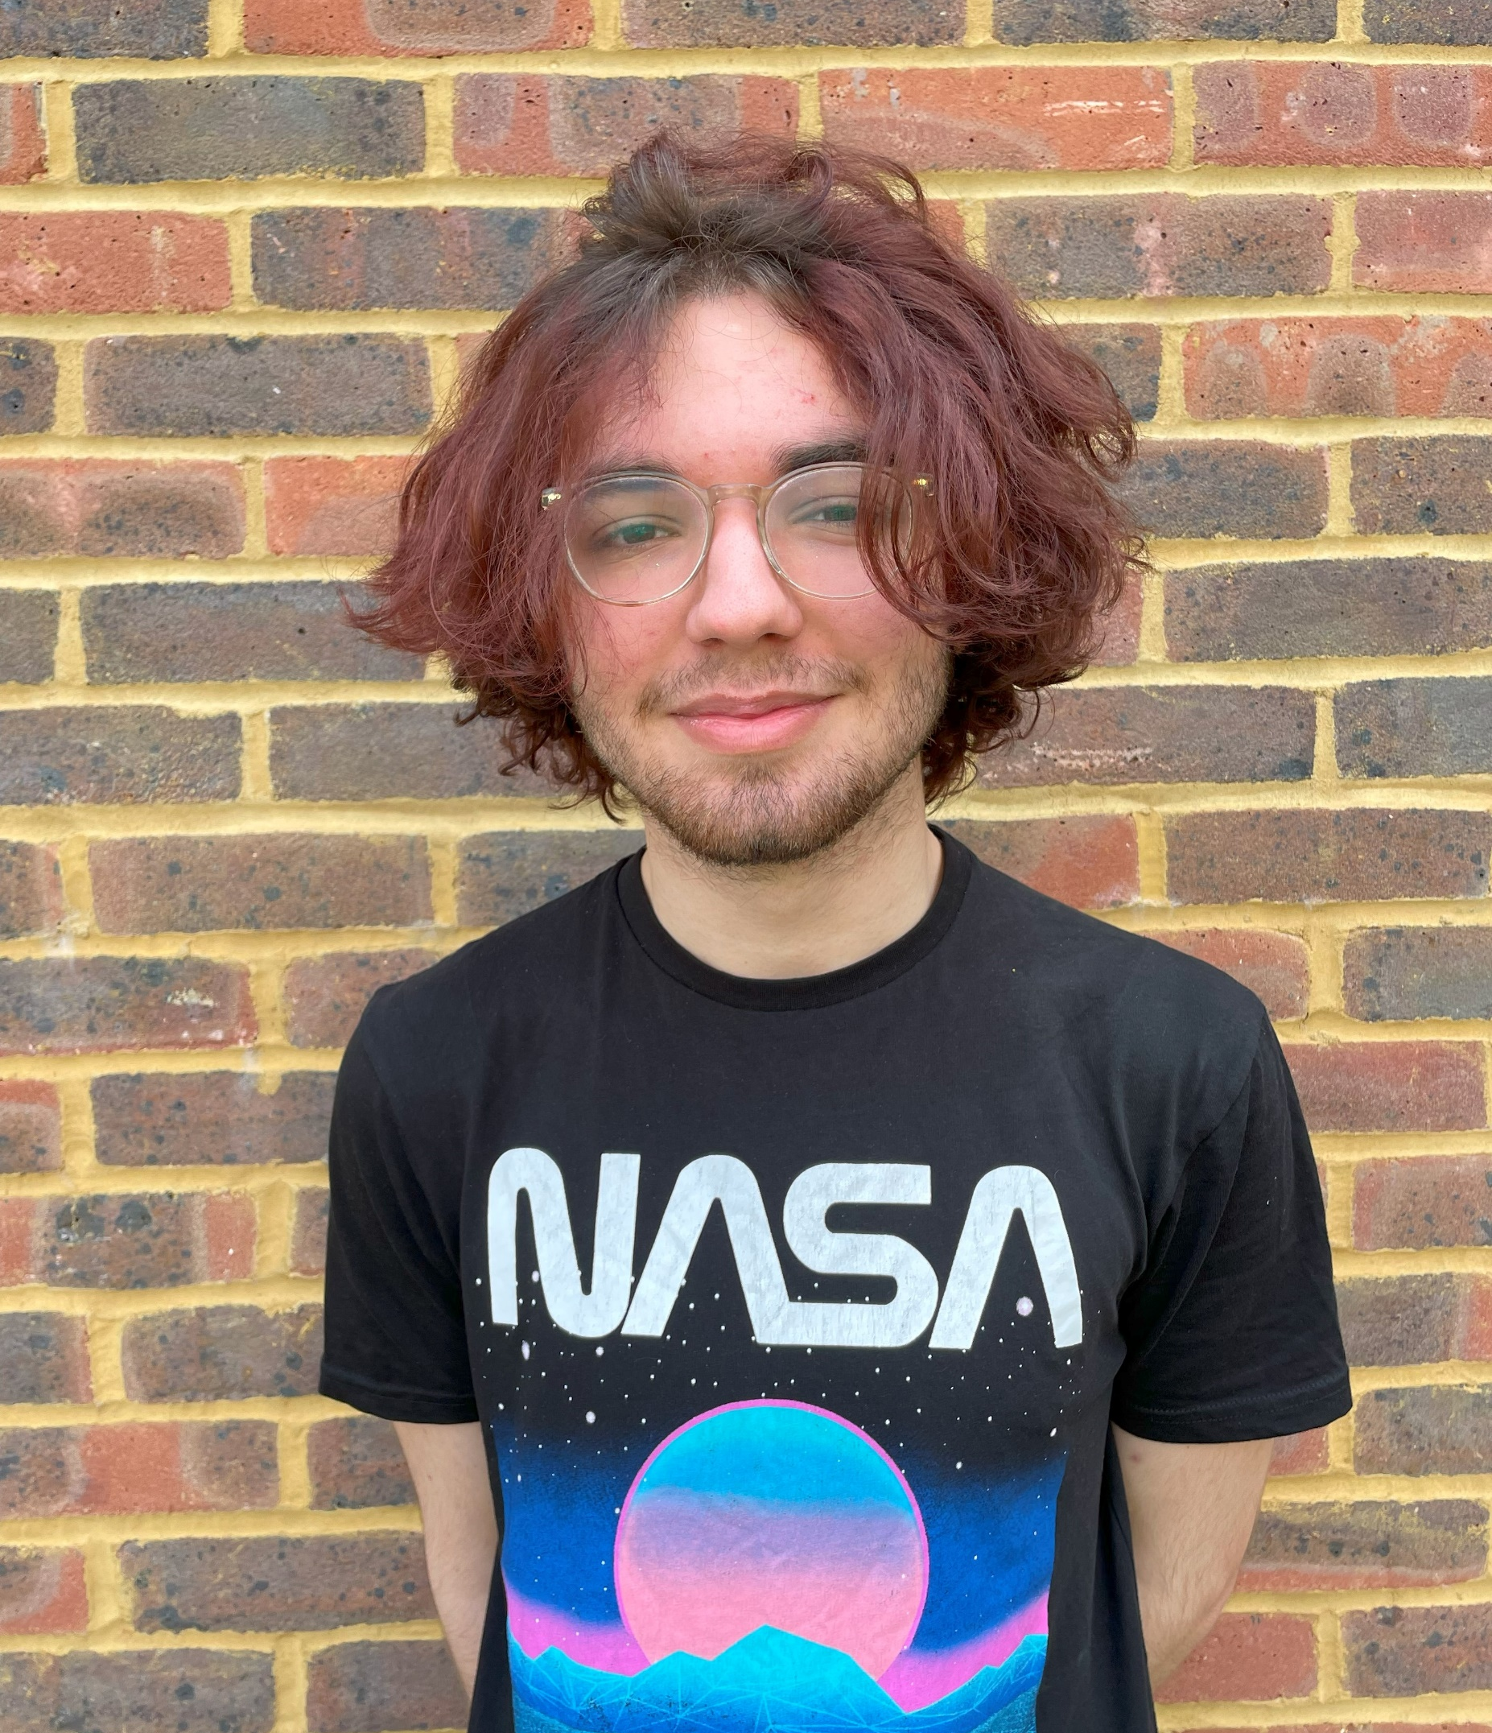
SU EVENTS EXEC
JAKE
SCHOOL : ESHER CofE HIGH SCHOOL
COURSES: PHILOSOPHY
POLITICS
FILM STUDIES

Slide 5
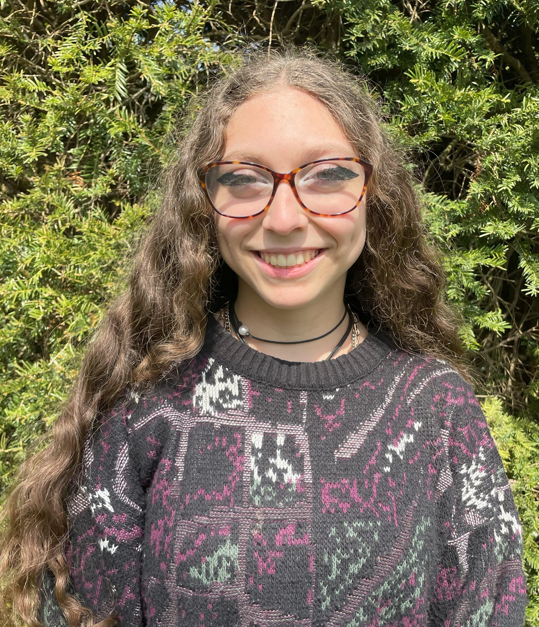
SU EQUALITY AND WELFARE EXEC
JAY
SCHOOL : EMANUEL SCHOOL
COURSES: ENGLISH LANGUAGE & LITERATURE
PSYCHOLOGY
PHILOSOPHY

Slide 6
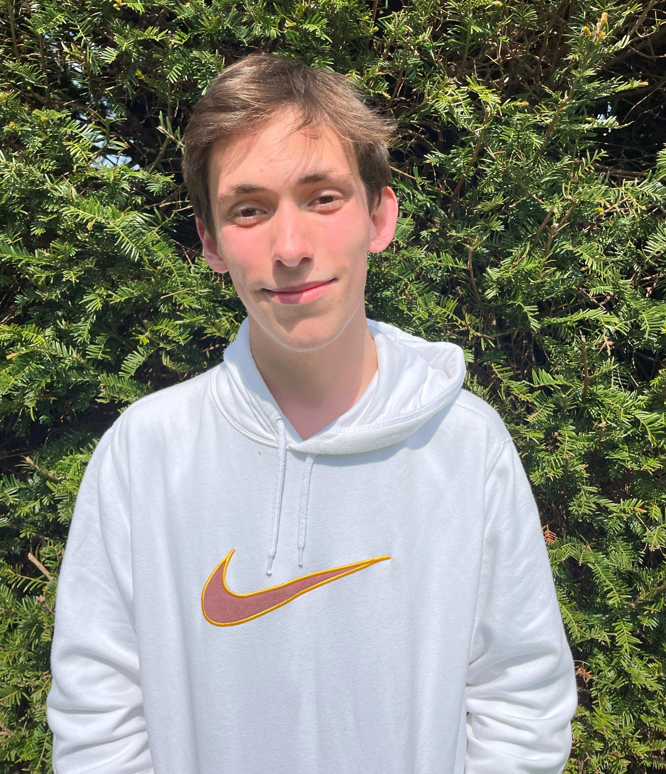
SU MARKETING EXEC
LIAM
SCHOOL : SUNBURY MANOR SCHOOL
COURSES: BUSINESS
HISTORY
POLITICS

