Slide 1
Welcome to Esher
Autumn Term 2023
Notes:
TAKE

Slide 2
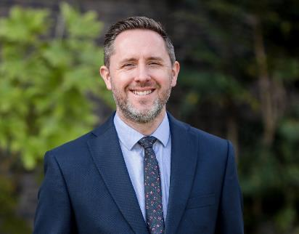
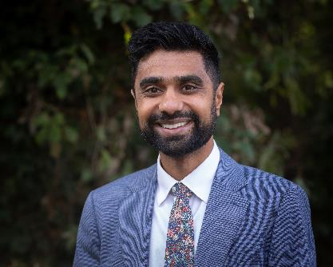
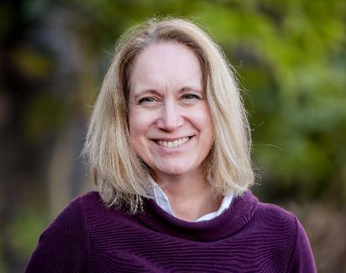
Senior Leadership Team
Dan Hards, Principal
Sagar Patel, Deputy Principal
Liz Bentley-Pattison, Assistant Principal
Kate Parsons, Assistant Principal
Notes:
TAKE

Slide 3
Welcome to Esher
Presentation
Student Panel
Meet Students in the Cafe
Notes:
NO

Slide 4
Why Esher Sixth Form College?
High quality specialist teaching and learning.
A broad and flexible A-level & BTEC curriculum offer.
Personal growth and development opportunities that enable our students to develop as individuals.
Facilities designed for post-16 education .
A diverse and inclusive College community.
Inclusive entry requirements.
Notes:
TAKE

Slide 5
The quality of education: Grade 1 - Outstanding
Personal development: Grade 1 – Outstanding
Behaviour and attitudes: Grade 1 – Outstanding
Leadership and management: Grade 1 – Outstanding
Provision for learners with High Needs: Grade 1 – Outstanding
Education Programmes for young people: Grade 1 – Outstanding
Notes:
TAKE

Slide 6
A level & BTEC Results
A level Results Summer 2023
Grade Profile | ESFC 2023 | JCQ National Benchmarks
Pass Rate | 98.1% (+0.8%) | 97.3%
High Grades (A*to B) | 58.9% (+5.4%) | 53.5%
A* | 9.2% (+0.3%) | 8.9%
BTEC Results (Two-year courses)
14 out of 17 courses 100% pass rate
Above 70% High Grades on Sub Diploma, Foundation Diploma and Diploma
ALPs A level T-Score: 3
Notes:
NO

Slide 7
HESA Data
Higher Education Statistics Agency – Degree Classification obtained by students 21/22 academic year
Provider | 1st and 2:1 Degree (All HEIs) | 1st and 2:1 Degree (Russell Group HEIs)
Esher Sixth Form College | 87.2% | 92.2%
Sixth Form College average | 80.5% | 88.8%
State sector average | 79.9% | 88.4%
Independent sector average | 88.6% | 92%
Notes:
NO – 10 MINS

Slide 8
The Curriculum
In 6.1 – students will study 3 or 4 courses plus a Complementary Study.
In 6.2 – students will study 3 or 4 courses plus a Progression Pathway.
Notes:
TAKE

Slide 9
A new approach to study
Learning to Learn
Initial assignments
Supervised Academic Study
10 hours
Subject study guides
PDP – Personal Development Programme
‘For students to develop as 6th form students into effective, independent, resilient and curious learners and be prepared for their next steps into education, employment or training.’
Notes:
TAKE?
Students are set initial assignments which will provide a broad introduction to the course. Once lessons begin, all courses deliver an induction programme which covers elements of the core skills and knowledge needed to be successful. Many subjects also conduct short benchmark assessments in order to ascertain where students are in terms of their subject knowledge. This enables teachers to support those students who need it and make any adjustments to the programme of study.
The other key aspect of our approach to study is our 10 hours message. We know from experience that all students need to be studying for at least 10 hours a week in order to fulfil their potential. Now, 4½ hours of that is lesson time but the remainder is made up of homework and independent study. All teachers will explain to students what this looks like in their subject and show them where to access suitable tasks and activities. We know that by getting into this type of routine means that students make the transition to university, apprenticeships or work more successfully.
To get a flavour of what 10 hours’ study looks like, students can access subject study guides when they log on to their application portal. All subjects are available to all students so they can work their way through individual booklets, or dip in and out of a variety of them.
We also deliver Learning to Learn through PDP –the Personal Development Programme – which is our tutorial programme. There are many sessions which are delivered by tutors on topics such as independent learning, organisational skills and revision. This starts from the very beginning of term.

Slide 10
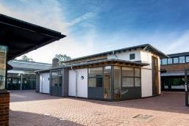
Personal Development
Personal Development
& Enrichment
Personal Development Programme
Complementary Studies
Specialist Services
In-House Counselling
Events
Your Start at Esher
Progression Pathways
Esher Extend
Trips, visits and speakers
Wider Skills Week
Mental Health Adviser
Study Centre – Team of Learning Mentors
Learning Resource Centres
Higher & Degree Apprenticeship Fair
Higher Education Day
Employment Seekers Evening
After Esher Day
Work Experience
Internship
Bursary
Progression Guidance
Full-time College Nurse
Notes:
TAKE

Slide 11
Entry Requirements
5 GCSEs grade 9-4 (A*-C for iGCSEs) is the minimum requirement to secure your place.
Vital to achieve at least a grade 4 or above in GCSE English Language.
Very important to achieve a grade 4 or above in GCSE Maths.
Some subjects require specific grades at GCSE (e.g. Maths, Sciences & Modern Languages).
Importance of good GCSE results:
- Firm foundation for success at A level and BTEC.
- Universities will look at your GCSE grades.
Notes:
TAKE

Slide 12
The Course Interview
A one-to-one discussion on Microsoft Teams.
We will want to find out the following:
GCSE grades you are likely to achieve.
Possible career plans.
To decide on a provisional study programme.
Chance for you to ask questions.
Opportunity to change options at Introduction Day or Enrolment.
Notes:
TAKE

Slide 13
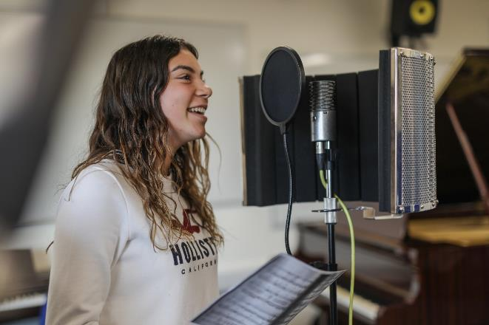
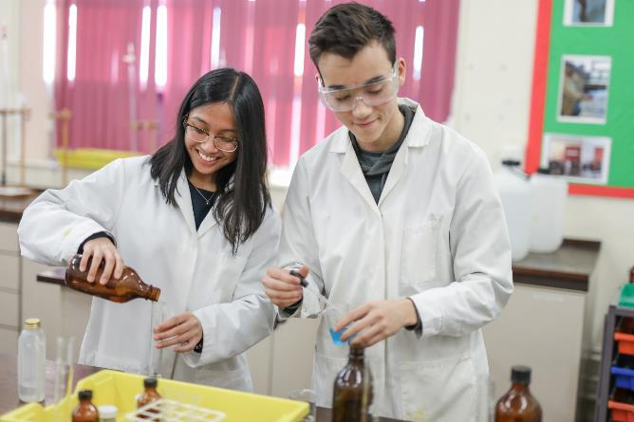
After your Course Interview
Following your interview, you will be sent a formal offer of a place by email.
You will need to login to your online account to accept your place within 2 weeks of receiving your offer.
Notes:
TAKE

Slide 14
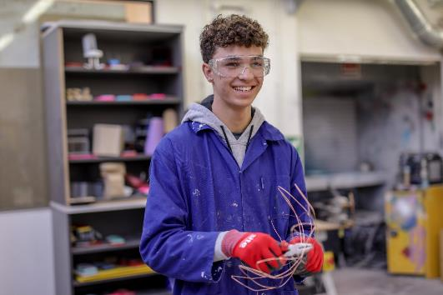
Your Place
You are guaranteed a place provided:
You agree a provisional study programme at interview.
You achieve 5 GCSEs grade 9-4 (A*-C in some GCSE qualifications).
Notes:
TAKE 10 MINS

Slide 15
Further Information
Takeaway Video & Presentation
Course FAQ Videos
College Website
College Tours
Notes:
TAKE

Slide 16
Future events
Course Interview
Between November 2023 & April 2024
Parents’ Information Evening
25th June 2024
Taster Day
27th and 28th June 2024
Enrolment
27th to 29th August 2024
Induction
3rd & 4th September 2024
Start of Teaching
9th September 2024
Notes:
TAKE 5 MINS

